Slide 1
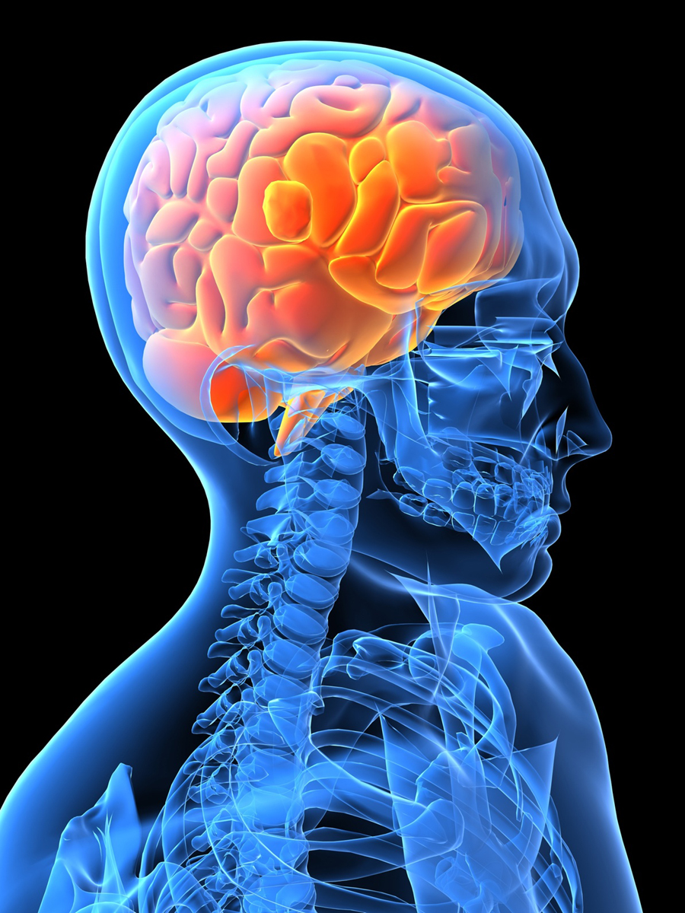
Ten Minutes About:
Stroke
Signs and
Symptoms
Your name
Date
class
Leslie A.
Lehrer RN,
BSN
Microsoft Clip Art

Slide 2
Stroke
“In the United States, approximately 700,000 strokes happen each year, most of which are caused by a blockage in a blood vessel. Strokes can cause long-lasting disability or even death”(Caplan, 2010).
As Advanced Practice Nurses, it is essential to have knowledge of this disorder and recognize early signs and symptoms of stroke.
Early intervention is key; time is mind.

Slide 3
By the completion of this lesson, the viewer will be able to:
Name the two types of strokes.
Recognize the common signs and symptoms of stroke.
Describe the pathophysiology behind the symptoms exhibited by the patient experiencing a stroke.

Slide 4
Case Study of Mr. CVA
Mr. CVA, a 76 year old man presented to the emergency room via ambulance after allegedly falling to the floor. His son stated that he had been complaining of a severe headache the day prior. The son noticed his unsteady gait prior to the fall and he appeared confused. It was determined after initial testing that Mr. Cva had ischemic stroke.
Microsoft Clip Art

Slide 5
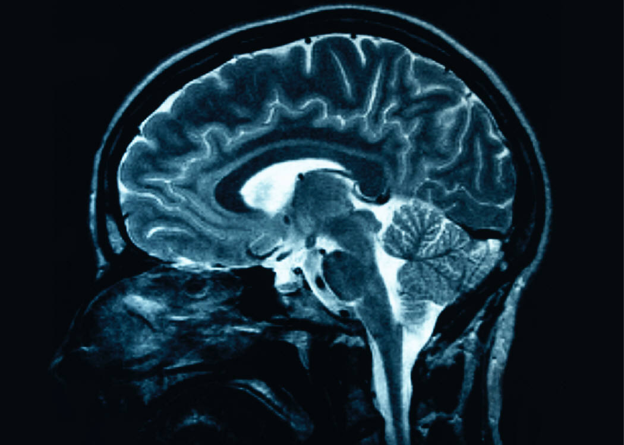
The two types of strokes
The two types: ischemic and hemorrhagic strokes. “Stroke is an acute focal neurologic deficit due to a disturbance in the blood vessels supplying the brain”(Porth, p.1318).
Microsoft
Clip Art

Slide 6
Ischemic Stroke
Ischemic Stroke accounts for approximately 85% of all strokes. With ischemic strokes, the arteries to the brain are narrowed or blocked, causing decreased blood flow to the brain producing ischemia. With this decrease of blood flow to the cells it deprives the area of oxygen and nutrients and cells die within minutes. Ischemic strokes are commonly caused by a thrombus or embolus (Porth, 2009).

Slide 7
Hemorrhagic Stroke
Hemorrhagic Stroke accounts for the other 15% and occur when spontaneous bleeding from a weakened artery starts and spills into the surrounding tissues damaging cells. Not only does the broken blood vessel cease the blood flow to the areas in the brain but the accumulation of blood produces a focal hematoma creating edema and increased intracranial pressure. This increased pressure can also cause spasming of adjacent blood vessels further decreasing blood flow to the brain (Porth, 2009).

Slide 8
Early Signs and Symptoms of Stroke
Stroke can affect many different areas, but for early warning signs remember FAST.
    FACE Sudden weakness in the face. Trouble seeing with one or both eyes. Facial drooping or the inability for the patient to smile. Severe headache or dizziness.
    ARMS Sudden weakness in the arms or legs.
    SPEECH Trouble speaking, patient behaving strange, acting confused, loss of balance, or unable to comprehend simple commands.
    TIME Call 911 if you observe any of these signs (Caplan, 2010).

Slide 9
Test Your Knowledge
What warning signs did Mr. Cva show that indicated possible stroke?
Unsteady Gait
Correct! Lack of blood flow to one side of the brain may paralyze the other side of the body.
Confusion
Correct! Decreased blood flow to an area of the brain will cause ischemia with memory issues.
Severe Headache
Correct! Blood is an irritant to the surrounding tissues. Along with lack of blood flow, hemorrhage will cause increased pain

Slide 10
Case Study of Mr. CVA
Mr. CVA slowly regained consciousness over the next couple days. However, he had the following symptoms:
    Facial asymmetry.
    Paralysis and loss of sensation on the right side of his face and arm.
    Inability to answer questions asked of him even though he was able to understand what was asked of him.
    Able to write down his responses much more easily than trying to speak those same answers.

Slide 11
Pathophysiology Behind the Stroke
The brain is extremely sensitive to decreased oxygen levels. Even the smallest amounts of ischemia can have devastating results for the patient.
The area of the cerebral vascular accident is often shown through the manifestation of signs and symptoms the patient exhibits. During a stroke, blood supply is disrupted to one area of the brain.
When the area becomes ischemic, cell death occurs rather rapidly through necrosis and apoptosis. The patient often exhibits symptoms that depend on the area of the brain that had been affected and the amount of actual damage that occurred during the infarct (Majid, A., Zamke, D., & Kassab, M., 2011).

Slide 12
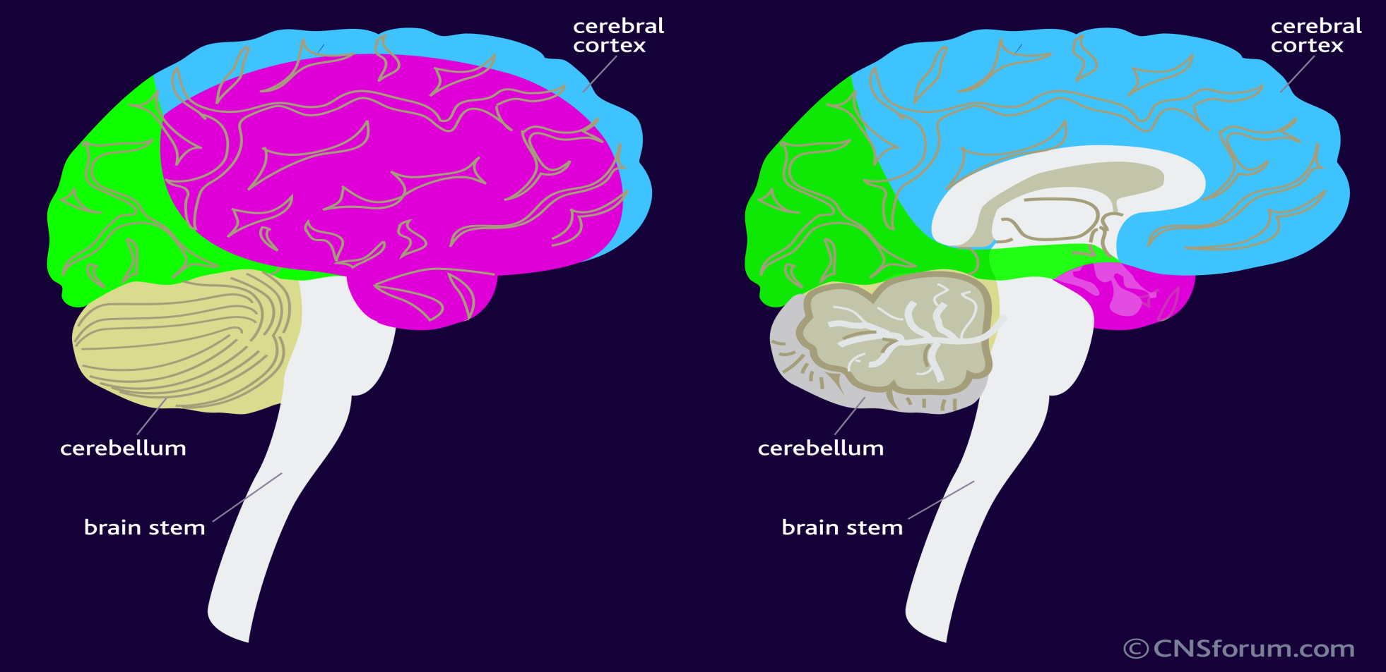
Three Cerebral Arteries Supplying the Cerebrum
Blue: Anterior Cerebral Purple: Middle Cerebral Green: Posterior Cerebral

Slide 13
Three Cerebral Arteries
Anterior Cerebral Artery
Middle Cerebral Artery
Posterior Cerebral Artery

Slide 14
Anterior Cerebral Artery
Branches off the internal carotid artery.
Supplies both the anterior and medial portions of the frontal and parietal lobes.
Least common area affected by strokes.
Classic signs of an Anterior Cerebral Artery stroke include opposite leg weakness and sensory loss (Tocco, S., 2011).

Slide 15
Middle Cerebral Artery
Branching off the internal carotid artery.
Largest vessel and the most common site for cerebral occlusion.
Supplies the frontal, temporal, and parietal lobes.
Also, feeds deeper internal structures like the basal ganglia and internal capsule.
Classic signs include facial asymmetry, arm weakness, speech deficits, hemiplegia, and contralateral sensory loss (Tocco, S., 2011).

Slide 16
Right vs Left Hemisphere Stroke
Left (or dominant) brain hemisphere can affect both expressive and receptive aphasia.
Right (or non-dominant) brain hemisphere can show signs of unilateral neglect (Tocco, S., 2011).

Slide 17
Posterior Cerebral Artery
Branches from the top of the basilar artery.
Supplies the medial occipital lobe and inferior and medial temporal lobes.
Classic signs include visual deficits and homonymous hemianopia which is a visual field defect involving seeing only the two right halves or the two left halves of both eyes (Tocco, S., 2011).

Slide 18
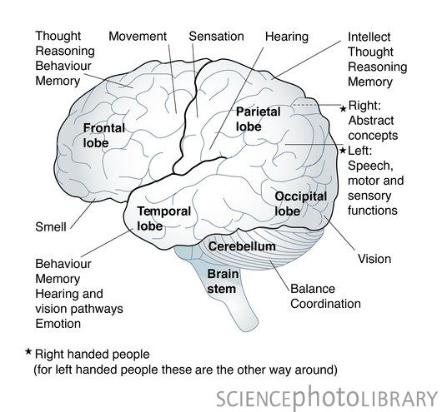
Google images

Slide 19
Case Study of Mr. CVA
Recap Mr. CVA’s symptoms:
    Facial asymmetry.
    Paralysis and loss of sensation on the right side of his face and arm.
    Inability to answer questions asked of him even though he was able to understand what was asked of him.
    Able to write down his responses much more easily than trying to speak those same answers.

Slide 20
Test Your Knowledge
Based on Mr. Cva’s symptoms, what area of the brain was compromised by the stroke?
Anterior
Possibly. Need more information.
Middle
Correct! Facial asymmetry, arm weakness, & speech.
Posterior
No, visual deficits not listed.

Slide 21
ACT FAST
Time is Mind
As Advanced Practice Nurses, it is essential to recognize early signs and symptoms of stroke.
It is important to obtain a timely detailed history, determining the onset of symptoms, and focusing on possible risk factors because time is mind.
Educate patients of the signs and symptoms and emphasize the importance of seeking medication attention within the first three hours of onset.

Slide 22
Test Your Knowledge
What stroke acronym identifies the early warning signs and symptoms?
FACE
Nope, this is a mnemonic used to remember musical notes
HELLP
Nope, this is a syndrome in which hemolytic and low platelets occurs
FAST
Correct!! Face, Arms, Speech, and Time

Slide 23
Let Us Review
More than 700,000 people suffer from stroke every year in the United States.
The brain is extremely sensitive to decreased oxygen levels. Even the smallest amounts of ischemia can have devastating results for the patient. Cell death occurs rather rapidly through necrosis and apoptosis.
The two types of stroke are ischemic and hemorrhagic.
There are three cerebral arteries, producing different symptoms.
Early signs and symptoms of stroke remember the acronym FAST: Face, Arms, Speech, and Time.
ACT FAST, Time is Mind.

Slide 24
References
Caplin, L. (2010, August 16). UpToDate. Patient information: Stroke symptoms and diagnosis (Beyond the Basic). Retrieved from UpToDate: http://www.uptodate.com/contents/patient-information-stroke-symptoms-and-diagnosis-beyond-the-basics.
Lundbeck Institute. CNS forum. The areas of the brain affected by stroke. Retrieved by Lundbeck Institute: http://www.cnsforum.com/imagebank/section/Stroke_AffectedAreas/default.aspx.
Majid, A., Zamke, D., & Kassab, M. (2011, June 16). UpToDate. Pathophysiology of ischemic stroke. Retrieved from UpToDate: http://www.uptodate.com/contents/pathophysiology-of-ischemic-stroke
Microsoft Office. (2012). Microsoft Office Clip Art.

Slide 25
References Cont.
Porth, C. M., & Matfin, G. (2009). Pathophysiology: Concepts of altered health states (8th ed.). Philadelphia, PA: Lippincott
Williams & Wilkins.
Tocco, S. (2001). Identify the vessel, recognize the stroke. American Nurse Today, 6(9), 8-11.

